Slide 1
SE6361 - Theia
Rupin Jairaj rxj200003@utdallas.edu
Wenlong Yang wxy200000@utdallas.edu
Mohit Anand mohit.anand@utdallas.edu
Sailesh Sriram sxs170005@utdallas.edu
Madhura Banerjee mxb162730@utdallas.edu
Jeya Visshwak Jeyakumar jxj190055@utdallas.edu

Slide 2
Outline
Introduction
Assumptions
Functional Requirements
Non-Functional Requirements
Traceability matrix
Questionnaire
Mockup
Issues
Ways around Issues

Slide 3

Problem
The UTD campus is not accessible for visually challenged people. They cannot navigate indoors without assistance from another person.
Other issues:
Unable to contact emergency services.
Unaware of alternate (less crowded) paths to destination.
Unable to identify obstacles ahead.
Unable to detect warning signs.

Slide 4
Problem Statement
The problem of | safe and quick navigation on the UTD campus
affects | the visually challenged people
the impact of which is | uncertainty in the safety and path to take to move around campus
a successful solution would be | a smartphone application that can aid the user in navigating from their current location on campus to their desired destination. The application would support calling emergency services or an emergency contact in case the user is in need of immediate assistance.

Slide 5
Goal
Help visually challenged people navigate UTD safely and help then reach their destination in the shortest time possible.
Other goals
Provide an easy way for the user to connect to their emergency contact.
Contact emergency services automatically when the user has fallen and is unresponsive.
Suggest possibly longer but a less crowded alternate path to destination.
Obstacle detection.
Warning/Danger sign detection.

Slide 6
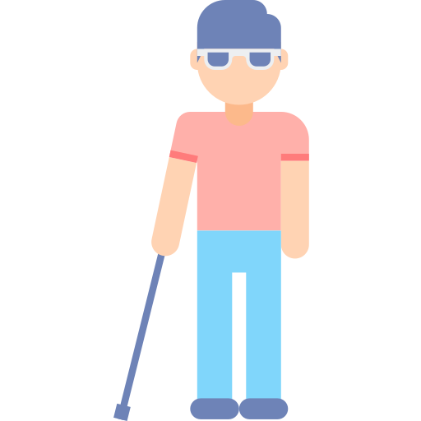
As-Is Scenario
A visually impaired student in unable to safely navigate to conference room ECSS 2.412.
The student does not know how to get there and is unaware of obstacles in his/her path.
Service dogs or canes cannot help with safe navigation with a high accuracy and safety.

Slide 7


To-Be Scenario
The visually impaired student uses Theia and enters the destination he/she wants to reach via voice commands.
Theia directs the student to his/her destination through the most convenient path calculated via audio instructions.
Theia also notifies the user of any obstacles or warning signs ahead of them.

Slide 8
Assumption
a walking stick, just in case
meet the minimum hardware requirements
stable internet connection
voice control or braille keyboard
corresponding sensors (3D detecting, camera, gyroscope)
hang the phone on the chest tightly
back of the phone fases the front
connected to earphones (noisy environment)
……

Slide 9
Functional Requirements
FR-1 | The app shall continue to stay in foreground once opened.
FR-2 | The app shall calculate the most convenient path from the current location to the destination.
FR-3 | The app shall be able to detect an obstacle and determine how to avoid it.
FR-4 | The app shall be able to place an emergency call to the secondary contact.
FR-5 | The app shall allow users to choose a route based on their own comfortability.
FR-6 | The app shall allow users to change their emergency protocol incase something happens.
FR-7 | The app shall pass Section 508 accessibility requirements.
FR-8 | The app shall recognize images (standard warning signs) for obstacle detection.
FR-9 | The app shall give the user an estimated time of arrival.

Slide 10
Non-Functional Requirements
NFR-1 | Supportability - The user shall install the app in a real-time environment.
NFR-2 | User-Friendly - The user shall access the app easily with no additional guidance required.
NFR-3 | Reliability - The app shall perform all tasks without failure.
NFR-4 | Enhanceability - The system shall offer updates easily whenever a newer version is available.
NFR-5 | Responsiveness - The app shall respond with a quick response time.
NFR-6 | Adaptability - The app shall work irrespective of the environment.
NFR-7 | Understandability - The app shall have a simple user interface and a clear user-manual.
NFR-8 | Customizable - The app shall be customized as per the user’s preferences.
NFR-9 | Reusability - The app shall be reused to improve its capabilities
NFR-10 | Useability - The app shall be easily controlled via user inputs.

Slide 11
Traceability Matrix - NFR to FR
 | FR-1 | FR-2 | FR-3 | FR-4 | FR-5 | FR-6 | FR-7 | FR-8 | FR-9
NFR-1 | + |  |  | + |  |  |  | + | +
NFR-2 |  | + |  | + | + | +
NFR-3 | + | + | + | + | + |  |  | + | +
NFR-4 |  |  |  |  |  |  |  | +
NFR-5 | + |  | + | + | + | + |  | + | +
NFR-6 |  |  |  |  | + |  |  |  | +
NFR-7 |  |  |  |  | + | + |  |  | +
NFR-8 |  |  |  |  |  |  |  | +
NFR-9 |  |  |  |  |  | +
NFR-10 |  | + |  | + | + | +

Slide 12
Environment
System
D1: App uses the phone camera for visual input.
D2: User must have his or her phone on him at all times when navigating
R1: App warns user of obstacles when detecting them
R2: The app will guide the user using an automated voice to destination given by user
R3: The app will notify emergency services within 30 seconds of detecting an emergency.
S1. App dictates directions via the audio output.
S2. App triggers phone vibrations warning the user of obstacles.
S3. App makes a call in case of emergency if there is no response from the user.
C1: Camera as the visual input.
C2: Buzzer as an actuator.
C3: Audio output as the primary feedback.
C3: GPS as the sensor to detect location.
P-Program

Slide 13
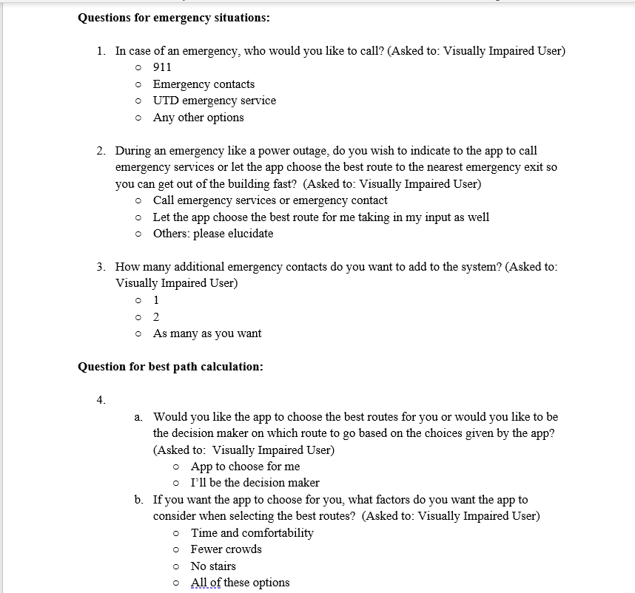

Slide 14
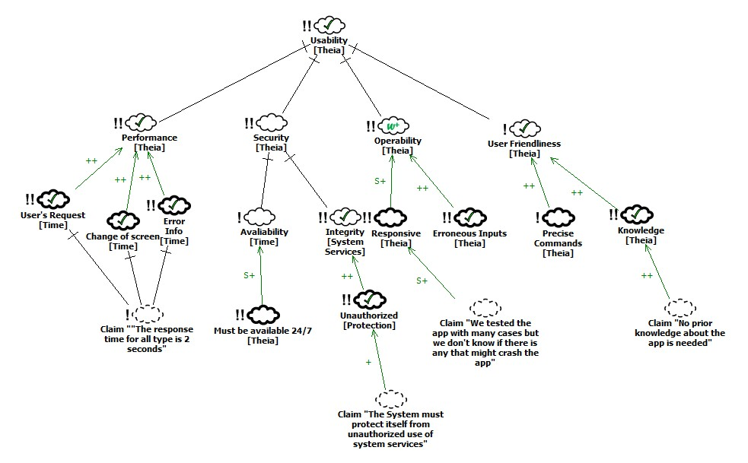
SIG

Slide 15
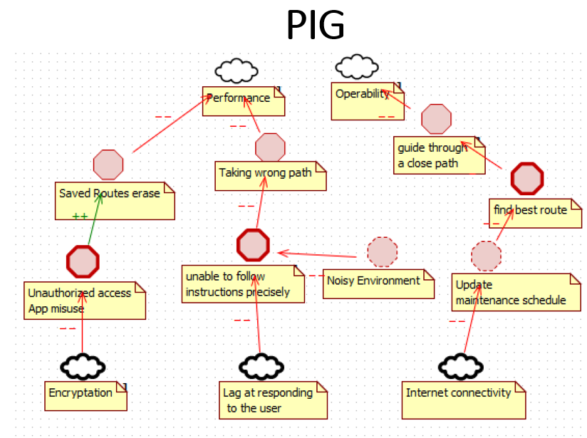
PIG

Slide 16
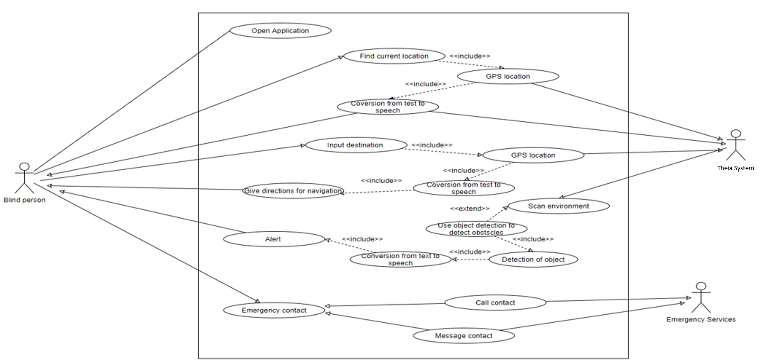
Use Case Diagram

Slide 17
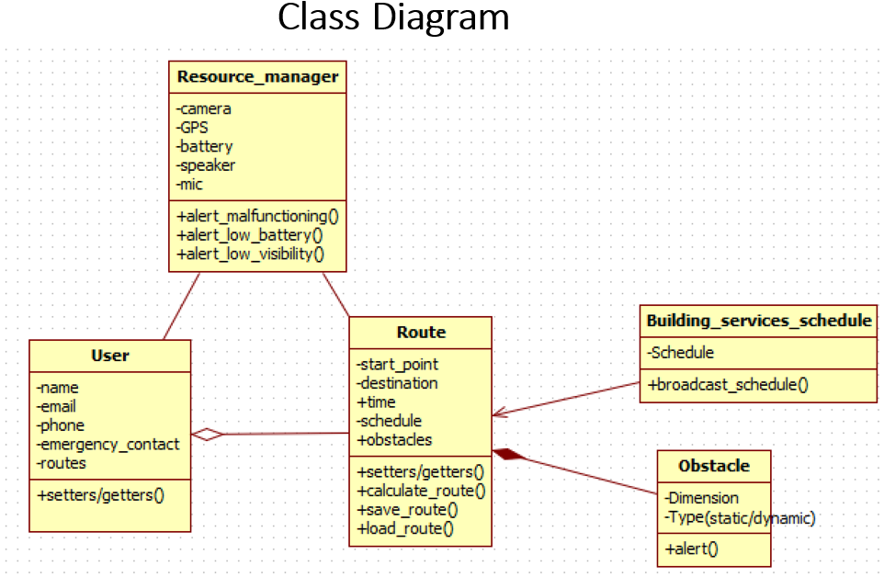
Class Diagram

Slide 18
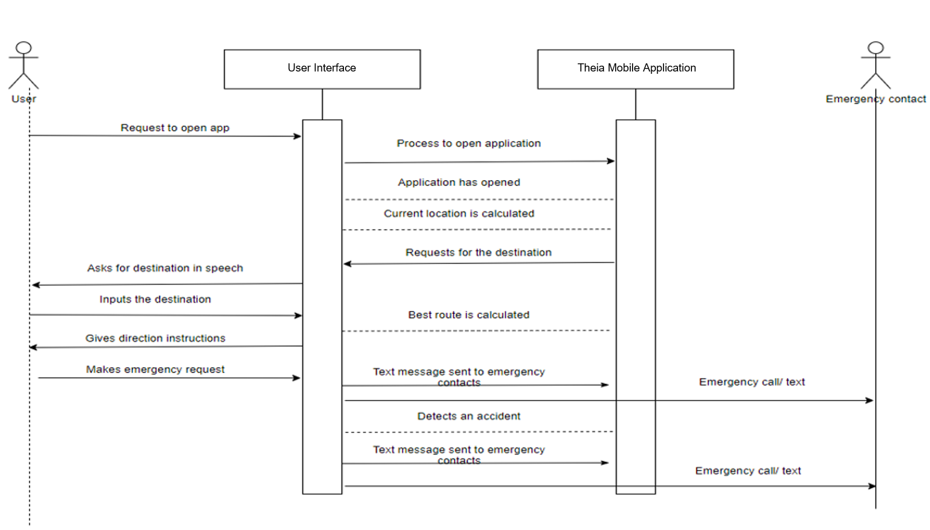
Sequence Diagram

Slide 19
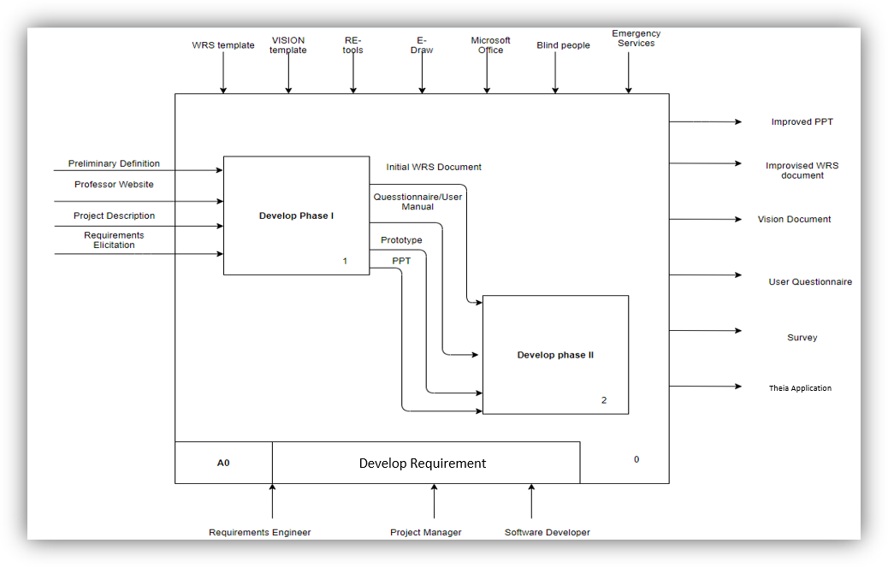
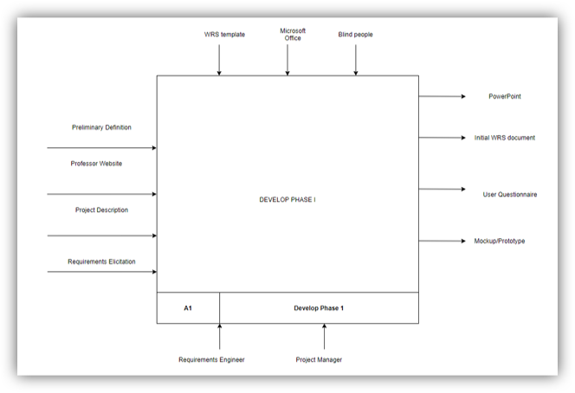
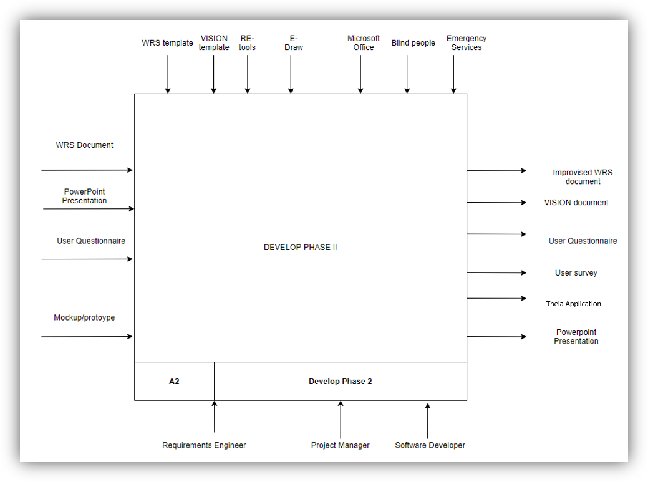
IDEF0

Slide 20
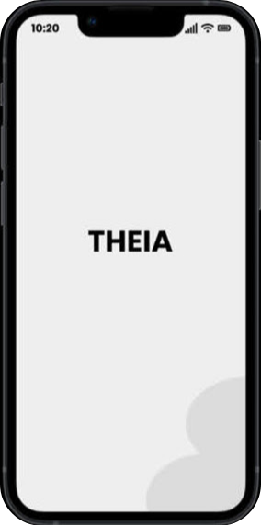
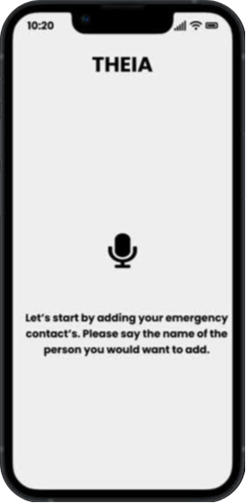
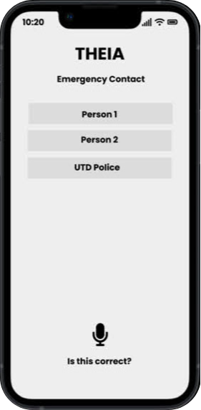

Slide 21
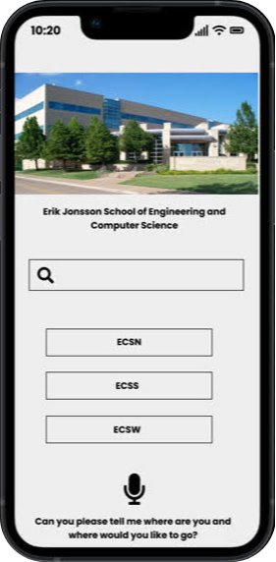
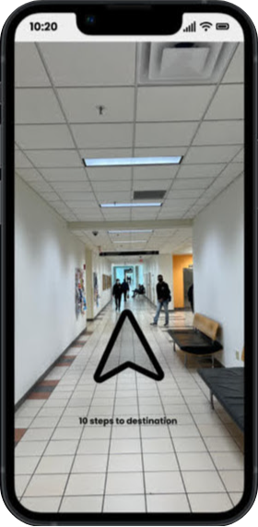
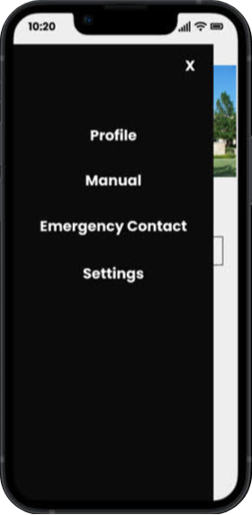

Slide 22
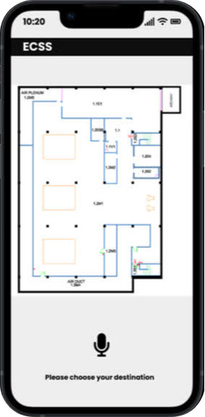
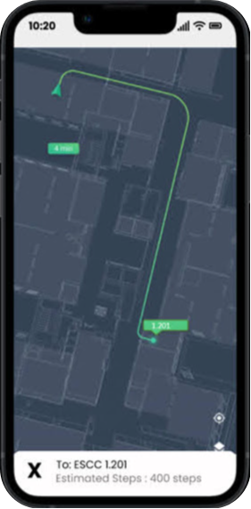

Slide 23
Issues
Domain/Stakeholder Issues:
What if the user is blind and deaf?
What if the secondary stakeholder assistant is not computer savvy?
Functional Requirement Issues:
Phone damaged and impacting app features
Not enough charge in battery for app to operate
Intermittent GPS issues
Start of navigation
During navigation
Within 3 feet of adjacent location
How will system know maintenance activities? (e.g., Restroom maintenance, new building)
Obstacles
Static Obstacles - Should the app direct to alternative routes?
Dynamic Obstacles - Should user wait? Object outside of view
Non-Functional Requirements Issues:
If secondary contact does not attend the call, should call be forwarded to the police?
How fast should the app respond to emergency situations and commands issued by the user?
How often should the user change their phones to meet the minimum hardware specification?

Slide 24
How We Handled Issues
Intermittent GPS Issues
Before or During:
Options:
Utilizing alternate means to guide user to destination like allowing system to convey user to use his or her walking stick or place call to emergency contact
Using number of steps and distance to calculate how far user is from destination
Allow system to convey to user to use his or her walking stick or place call to emergency contact
Within 3 Feet:
Options:
Use system’s knowledge of map of building to indicate number of steps to next braille
How will system know maintenance activities?
Options:
Actively identifying bathroom maintenance or wet floor signs through image detection feature and calculating path around maintenance area
Automatic updates to system when maintenance is being done within the building. System is connected to email of user.
What if user is blind and deaf?
Options:
We will give user the option to use a customizable braille keyboard that can be attached to the app screen and navigate the user

Slide 25
How We Handled Issues
What if secondary stakeholder is not tech savvy?
Options:
We will give manual to secondary stakeholder on how to use the app and set it up
If secondary contact does not attend the call, should call be forwarded to the police?
Options:
Allowing access to user’s contacts and allowing user to say who they want to contact
Have call go to the UTD police
How fast should the app respond to emergency situations and commands issued by the user?
Options:
The app will communicate to emergency services if user does not respond within 25 seconds
How often should the user change their phones or update the app to meet the minimum hardware specification?
If the phone’s hardware or software does not meet the minimum specification to run the app, the user must update or change his or her phone

Slide 26
Creep Rate
Our system has a relatively low creep rate of 15%.
Creep rate is low because:
the project is relatively small.
there is thorough traceability between functional and non-functional requirements.
the process is well documented and constantly revised.

Slide 27
Why our applications is better
Flexible Process
Agile/Sprint Development
Consistent interaction and collaboration with customers
Understand notion of ethnomethodology
Good Design Principles
Prioritization of important requirements
Smart developers
Good collaboration with domain experts to understand the day of a visually impaired person

Slide 28

Demo

Slide 29
Thank You
Q & A

